Slide 1
Exploratory Data Analysis on Bikeshare Data
Team KaZAM
Woochan Lee
Ziyan Xia
Yueni Wang

Slide 2
Agenda
Key Statistics & Assumptions ------------------------------ P3
Exploratory Data Analysis ------------------------------ P4-P7
Station clustering on Washington DC map ------ P4
Frequency of bike rides throughout the day ------ P5
Frequency of bike reshuffles throughout the day ------ P6
Influence of weather on total bike rides ------ P7
Feature Engineering (Ongoing) ------------------------------ P8

Slide 3
Key Statistics & Assumptions
Key statistics for 2019 data
Assumptions:
We chose to focus on 2019 data as 2020 and 2021 datasets could contain unpredictable behaviors due to COVID; we wanted the model to learn from the “normal times”, and build accurate models as a first step
Reshuffling occurred if a bike arrived at station A, but later left at station B; we assumed that the reshuffle happened exactly halfway in time
The starting numbers of bikes in each station in 2019 are the total number of bikes that arrived at a station in December 2018 and did not leave
We assumed that weather data (precipitation,and temperature) for certain stations could represent the overall weather for the entire Washington DC area we were concerned with
Total # of trips | 7,494,726
Total bike rides | 6,797,334 (~90.7%)
Total bike reshuffles | 697,392 (~9.3%)
Total # of stations | 582

Slide 4
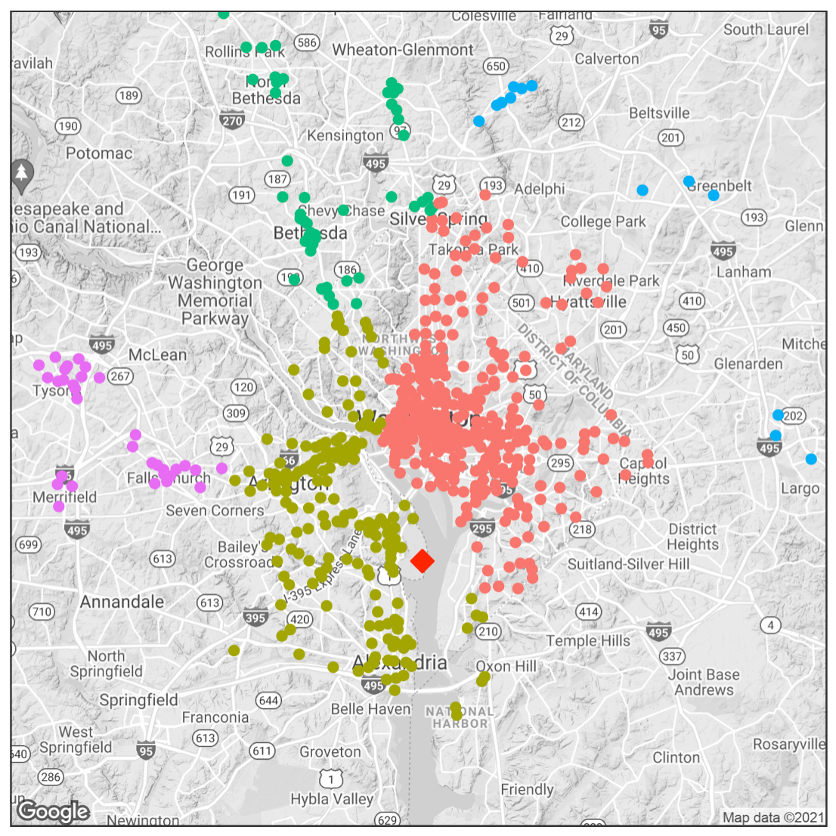
Exploratory Data Analysis
Station clustering on Washington DC map
Hierarchical clustering was used to cluster the stations into 5 groups based on their longitude and latitude values in the map
We observed that the average number bike rides for cluster 1 was the highest
Suggests cluster 1 is a “high demand” urban area with more frequent bike ride activity overall
This cluster contains The White House, Capitol Hill, and high density of commercial buildings
Cluster Type | Cluster 1 | Cluster 2 | Cluster 3 | Cluster 4 | Cluster 5
Total number of Stations | 329 | 177 | 68 | 16 | 67
Average number of bike trips per station | 16,703 | 4,809 | 1,489 | 56 | 676
Weather Station
Notes:
Process:
Motivations for clustering
Because of potential variation of bike availability across different stations, we wanted to explore on subset/clusters of stations that showed similar characteristics. (variation, subset, similar)
Also, we wanted to restrict our scope to a limited subset of stations first to ensure we had a good and accurate model before building up to include the whole area of Washington DC. (limited, expand)
How is the clustering helpful ?
First, we expect the cluster results to give us the hints about what kind of the stations we should focus on.
Second, if different clusters of stations are quite different from others, then we can give them different labels, which may assist and simplify our model building when we decide to expand to other clusters of stations cause we probably won’t use the longitude and latitude as our input data.
Third, our original hypothesis was that urban areas (office buildings, main street) would involve higher average bike ride activity and show similar characteristics of bike availability. We used the Washington DC map to further interpret characteristics of clusters and justify our hypothesis. (make sense of the clustering results)
(First: hints;
Second: label model expand;
Third: hypothesis )
Which clustering method did we use and why?
We chose hierarchical clustering method because we wanted to gain several both geographically and quantitatively different clusters of stations on the map. I’ll tell you how this cluster result achieve the goal. “The quantitatively different” here I mean they vary a lot in average number of rides of all in-cluster stations, which indicates whether this area is a high-demand area or low-demand area. This method allows us to cluster the stations based on their longitude and latitude so we are able to have some clusters like this on the map.
Our key assumption was that higher average bike activity would mean a more dynamic variation in bike availability in a cluster. (This means that the stations in cluster 1 likely share the same bike availability characteristics)
Cluster result:
explain the graph in detail and explain the table
.

Slide 5
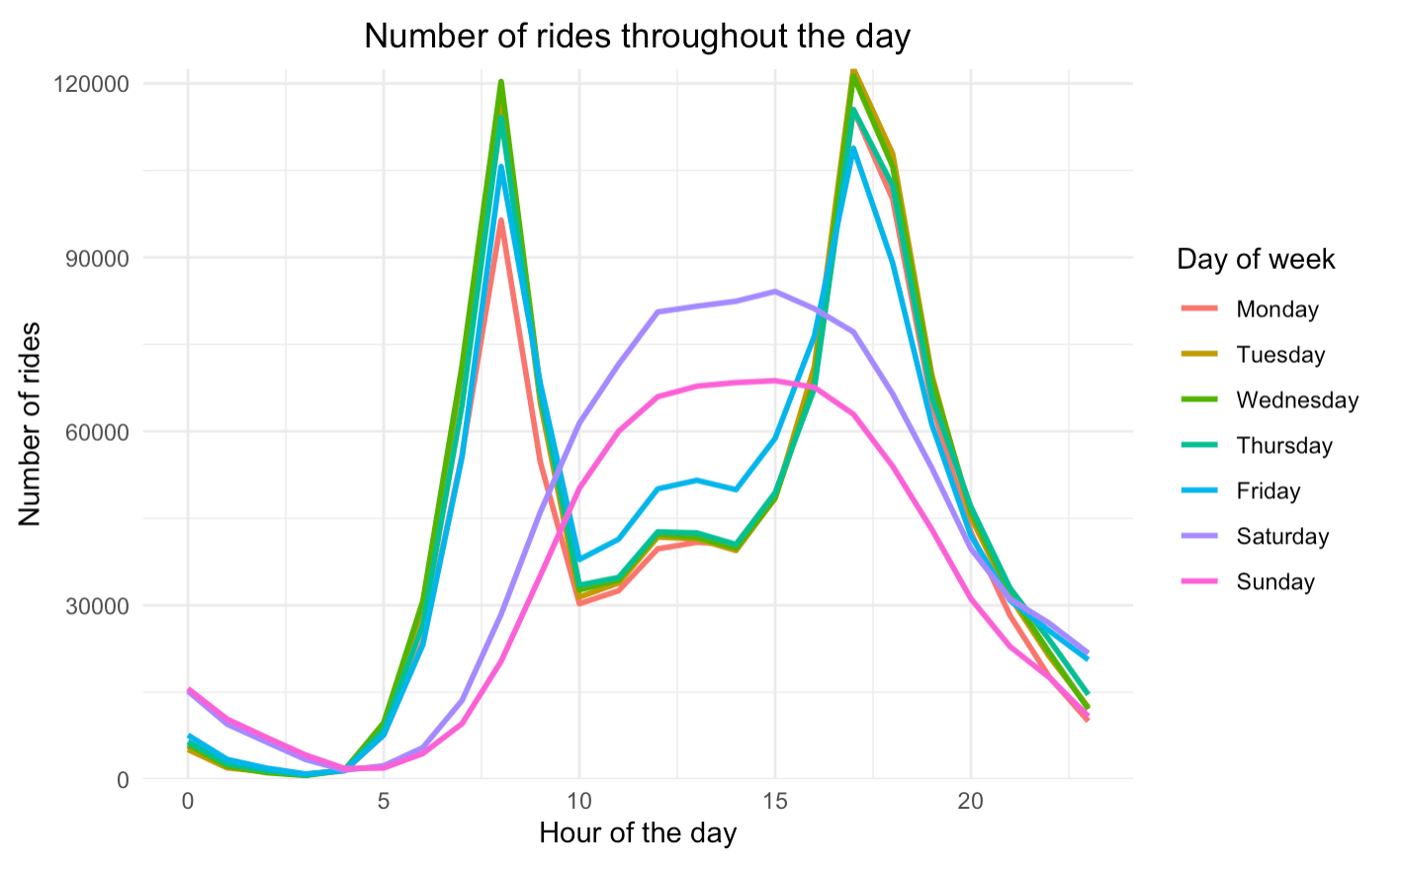
Exploratory Data Analysis
Frequency of bike rides throughout the day
There are separate distinctive patterns for weekdays and weekends
During weekdays, the peak number of bike rides occurs during rush hours of 7am to 8am, and 5pm to 6pm
During weekends, the peak is not as distinctively defined as weekdays. It tends to gradually rise around noon and gradually fall towards evening time
Notes:
Add title to the

Slide 6
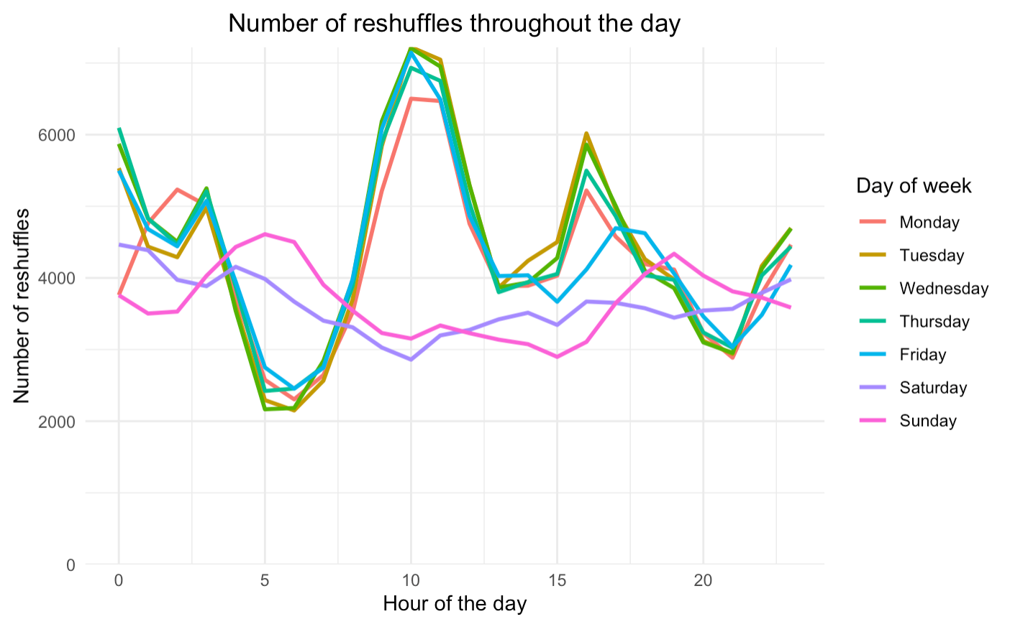
Exploratory Data Analysis
Frequency of bike reshuffles throughout the day
There are distinctive patterns for weekdays and weekends that oppose the pattern shown in the previous slide
During weekdays, a lot of the peaks occur before and in between rush hours (12am, 10am, and 4pm), and drops low during rush hours
During weekends, the peak is not as distinctively defined as weekdays and only show slight variations throughout the day
Notes:
Add some summary here

Slide 7
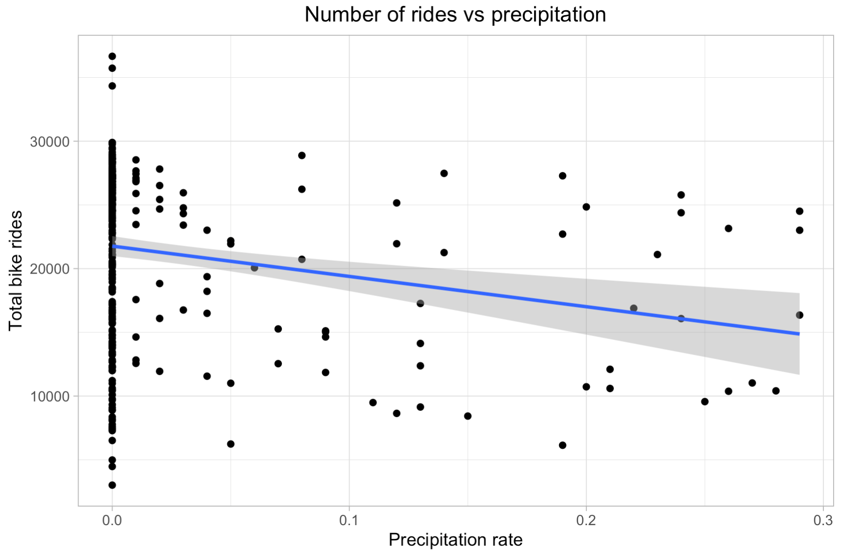
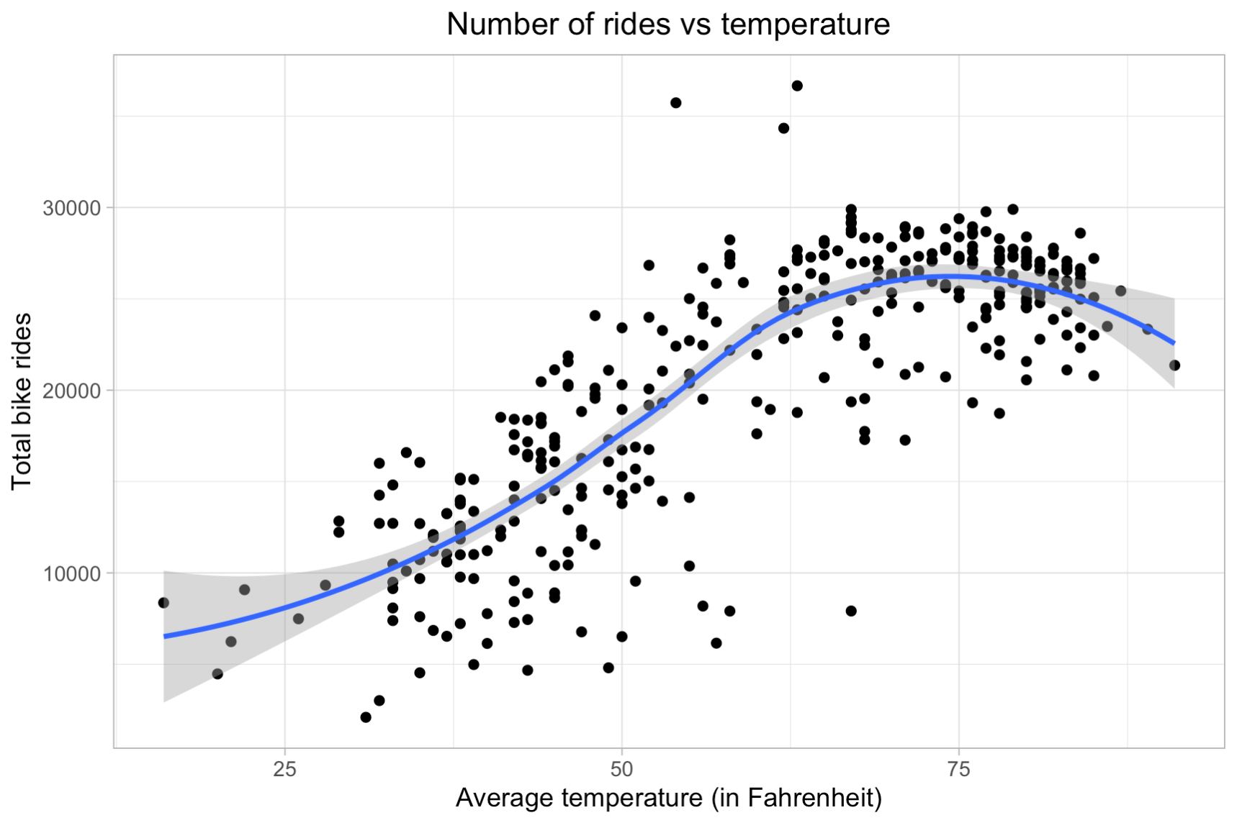
Exploratory Data Analysis
Influence of weather on total number of bike rides
The general trend seems to be that as precipitation rate increases, the total number of bike rides decreases
It is apparent that there is a data imbalance for precipitation rates
There tends to be higher number of bike rides when the temperature reaches 75°F, while the curve decreases as the temperature reaches extreme values in both directions
This is understandable, since people would avoid riding bikes during extremely hot and cold temperatures

Slide 8
Feature Engineering (Ongoing)
Using insights obtained from EDA, we are currently in progress of transforming the dataset in the format we need to measure availability of bikes in each station per each trip. The following format would be useful to generate our final dataset to feed to the model.
Potential predictor variables:
act: “1” : bike dropped-off
“-1”: bike picked-up
reshuffle: “1” : reshuffle trips
“0” : normal trips
tot_capacity: total bike capacity in a station
weekend: “1” : trip occurred in the weekend
“0” : trip occurred in the weekday
hour : the hour of the day when the trip occurred
rush_hour: “1” : trip occurred during rush hours
“0” : trip occurred during non-rush hours
prcp: precipitation rate at the day of the trip
avgt: average temperature at the day of the trip
Response variable:
availability: the cumulative sum of "act" in ascending time
Notes:
AWND: average daily wind speed
PRCP: Precipitation
TAVG: average temperature

Slide 9
Thank you!

